Slide 1




Detecting Subsequence Anomalies
in Time Series
ECML/PKDD 2024 Tutorial
An Introduction to Machine Learning from Time Series
Sebastian Schmidl
sebastian.schmidl@hpi.de
Phillip Wenig
phillip.wenig@hpi.de
Thorsten Papenbrock
papenbrock@uni-marburg.de
Hasso Plattner Institute (HPI)
University of Potsdam
Germany
Hasso Plattner Institute (HPI)
University of Potsdam
Germany
Big Data Analytics
Philllipps-University of Marburg
Germany

Slide 2
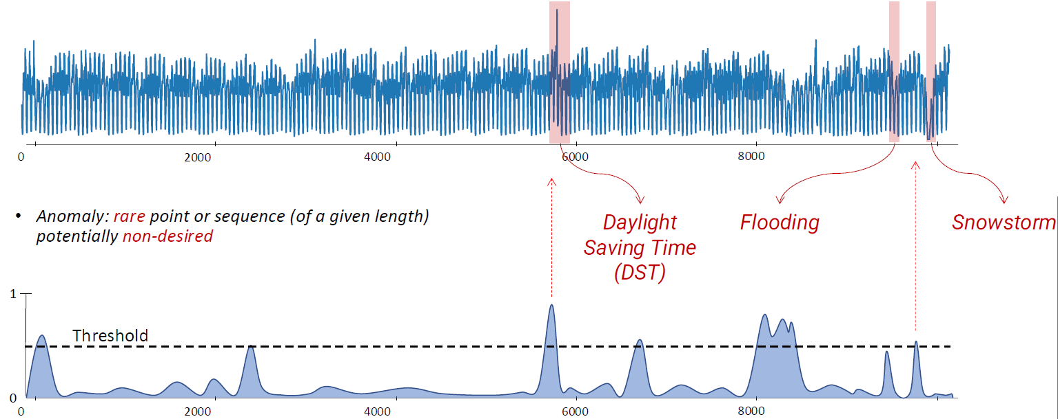
Introduction
Day
„
An anomaly is a point or a sequence of points that deviate w.r.t. some measure or model from the regular patterns of the time series.
“
Week
For this tutorial:
A potentially undesired rare point or rare sequence of points of a given length.
Low Score: Normal
High Score: Anomalous
Image from Boniol et al. Time-Series Anomaly Detection: Overview and New Trends. VLDB 2024

Slide 3



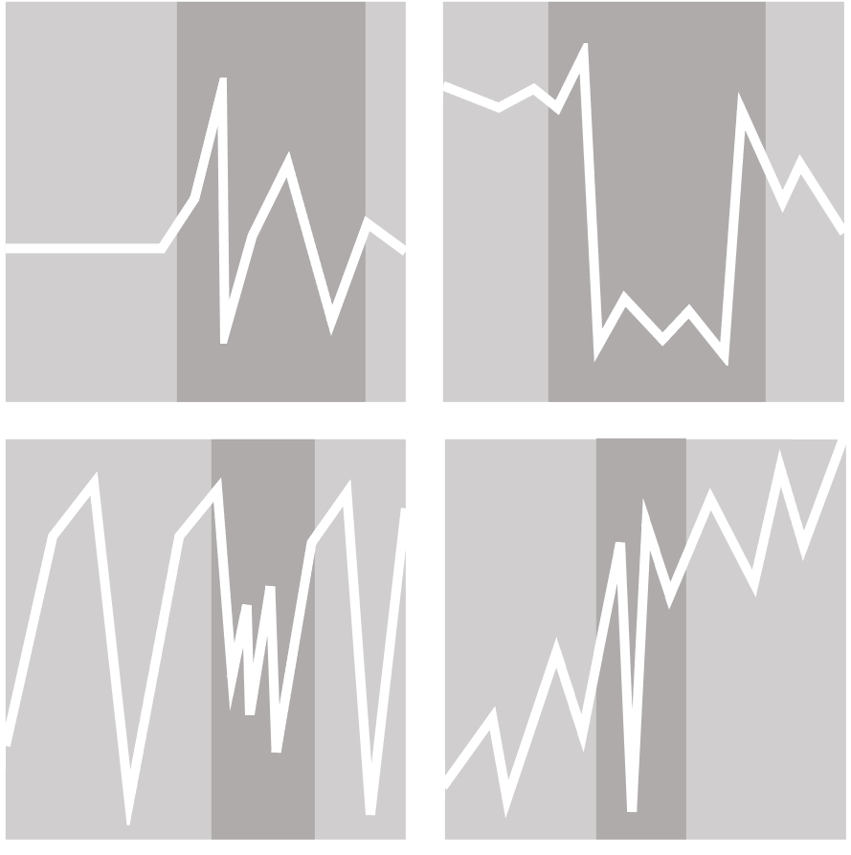


Outline
Time Series Anomalies
Anomaly Detection Methods
TSAD Benchmarks & Datasets
Outlook

Slide 4
Time Series Anomalies
ECML/PKDD 2024 Tutorial
An Introduction to Machine Learning from Time Series

Slide 5



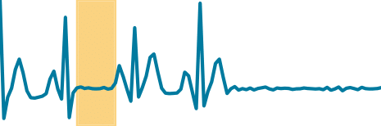
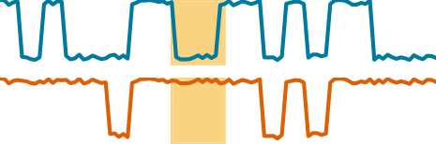
Anomaly Taxonomy
Anomaly Types
Point
Subsequence
Correlation
Global
Contextual
Global
Contextual
Global
Contextual
Phillip Wenig, Sebastian Schmidl, Thorsten Papenbrock: Anomaly Detectors for Multivariate Time Series: The Proof of the Pudding is in the Eating. Proceedings of the International Conference on Data Engineering Workshops (ICDEW), 2024. DOI:10.1109/ICDEW61823.2024.00018

Slide 6
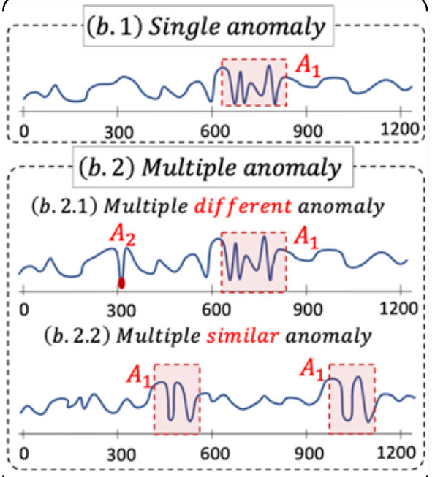
Anomaly Taxonomy
Anomaly Arity
for multivariate time series
how many channels are affected
n-ary anomaly: anomaly affects n channels/dimensions of the time series
Image from Boniol et al. Time-Series Anomaly Detection: Overview and New Trends. VLDB 2024

Slide 7
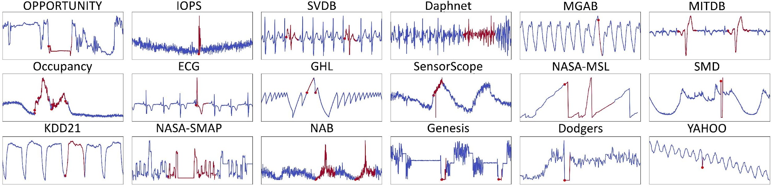
Real-world examples
global point
contextual subsequence
global subsequence
multiple similar
contextual point
Image from TSB-UAD repository.

Slide 8
Anomaly Detection Methods
ECML/PKDD 2024 Tutorial
An Introduction to Machine Learning from Time Series

Slide 9
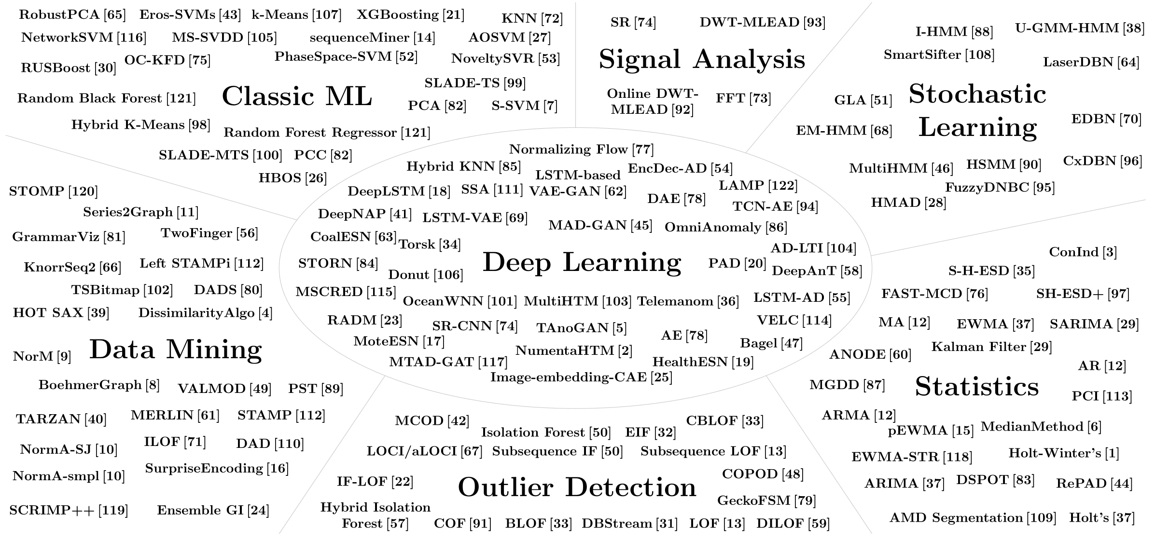
Anomaly Detection Methods – by Research Domains
Sebastian Schmidl, Phillip Wenig, Thorsten Papenbrock: Anomaly Detection in Time Series: A Comprehensive Evaluation. PVLDB 9:(15), 2022. DOI:10.14778/3538598.3538602

Slide 10
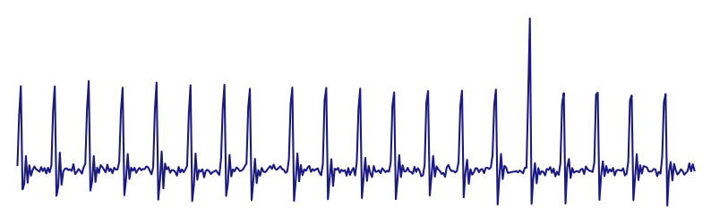

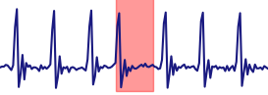
Anomaly Detection Methods – by Learning Type
Training
Testing
Unsupervised
(Type I [a])
Supervised
(Type II [a])
Semi-Supervised
(Type III [a])
[a] Victoria J. Hodge and Jim Austin. 2004. A Survey of Outlier Detection Methodologies. Artificial Intelligence Review, 22, 2, 85–126. doi: 10.1007/s10462-004-4304-y

Slide 11






Anomaly Detection Methods – by Family
Forecasting
Reconstruction
Encoding
Distance
Distribution
Isolation Tree

Slide 12
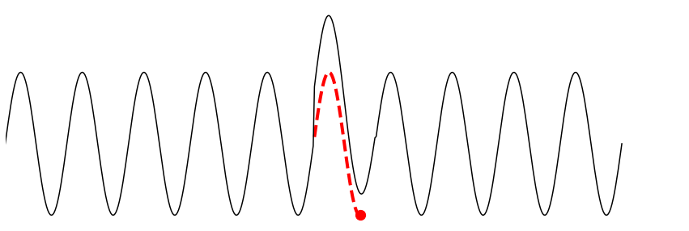
Anomaly Detection Methods – by Family
Forecasting
ARIMA, DeepAnT, DeepNAP, HealthESN, LSTM-AD, MedianMethod, MTAD-GAT, NumentaHTM, NoveltySVR, OceanWNN, RBForest, RForest, SARIMA, Telemanom, Torsk, Triple ES, XGBoosting

Slide 13
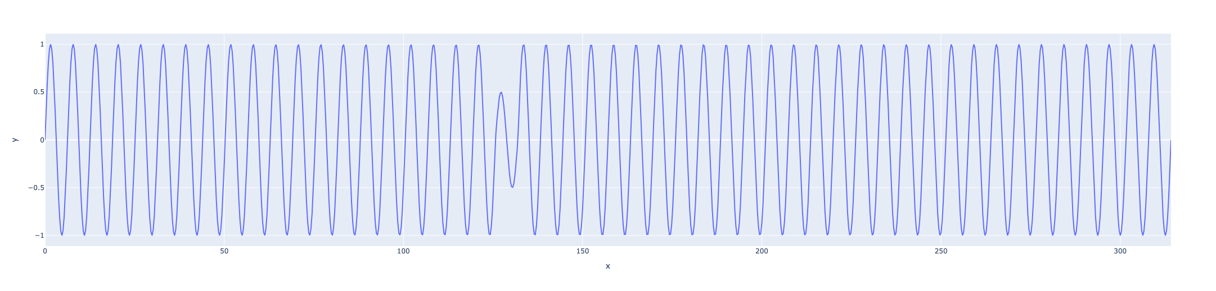
Forecasting Methods
Methods try to forecast the next point or sequence of points based on previous window
Anomaly score = prediction error
window of length m

Slide 14
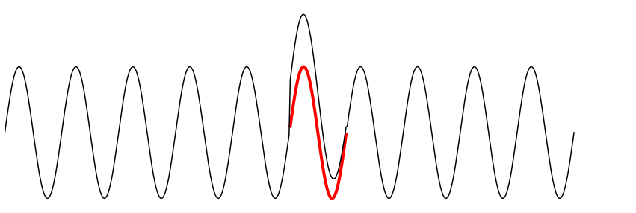
Anomaly Detection Methods – by Family
Forecasting
Reconstruction
ARIMA, DeepAnT, DeepNAP, HealthESN, LSTM-AD, MedianMethod, MTAD-GAT, NumentaHTM, NoveltySVR, OceanWNN, RBForest, RForest, SARIMA, Telemanom, Torsk, Triple ES, XGBoosting
AE, Bagel, DAE, Donut, EncDec-AD, FFT, IE-CAE, LSTM-VAE, MSCRED, OmniAnomaly, PCI, PCC, RobustPCA, SR, SR-CNN, TAnoGan

Slide 15
Reconstruction Methods
Training: Methods build normal model by encoding normal subsequences in latent space
Testing: Methods try to reconstruct subsequences from latent space
Anomaly score = reconstruction error
window of length m

Slide 16
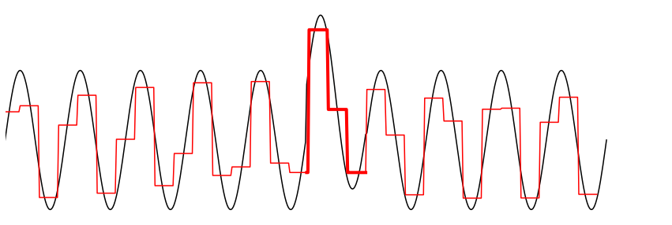
Anomaly Detection Methods – by Family
Forecasting
Reconstruction
Encoding
ARIMA, DeepAnT, DeepNAP, HealthESN, LSTM-AD, MedianMethod, MTAD-GAT, NumentaHTM, NoveltySVR, OceanWNN, RBForest, RForest, SARIMA, Telemanom, Torsk, Triple ES, XGBoosting
AE, Bagel, DAE, Donut, EncDec-AD, FFT, IE-CAE, LSTM-VAE, MSCRED, OmniAnomaly, PCI, PCC, RobustPCA, SR, SR-CNN, TAnoGan
Ensemble GI, GrammarViz, LaserDBN, MultiHMM, PST, Series2Graph, TARZAN, TSBitmap

Slide 17
Encoding Methods
Methods encode subsequences in latent space and identify anomalies in this space
Anomaly score = depends on representation
window of length m
[abba]
[cdaa]
[baab]
GrammarViz: Coverage of grammar rules
Series2Graph: Edge weight
TsBitmap: Bitmap similarity
…

Slide 18
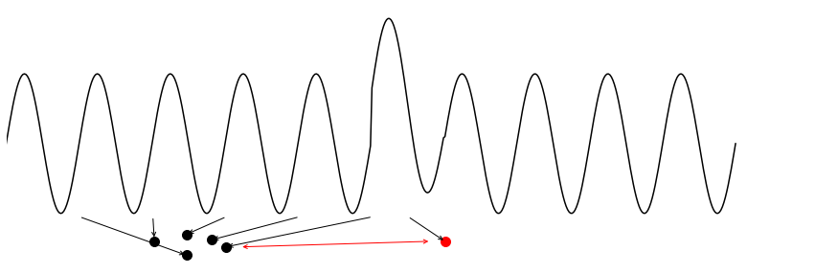
Anomaly Detection Methods – by Family
Forecasting
Reconstruction
Encoding
Distance
ARIMA, DeepAnT, DeepNAP, HealthESN, LSTM-AD, MedianMethod, MTAD-GAT, NumentaHTM, NoveltySVR, OceanWNN, RBForest, RForest, SARIMA, Telemanom, Torsk, Triple ES, XGBoosting
AE, Bagel, DAE, Donut, EncDec-AD, FFT, IE-CAE, LSTM-VAE, MSCRED, OmniAnomaly, PCI, PCC, RobustPCA, SR, SR-CNN, TAnoGan
Ensemble GI, GrammarViz, LaserDBN, MultiHMM, PST, Series2Graph, TARZAN, TSBitmap
CBLOF, COF, DBStream, HOT SAX, Hybrid KNN, k-Means, KNN, LOF, NormA-SJ, PS-SVM, SAND, SSA, STAMP, STOMP, Sub-LOF, VALMOD, Left STAMPi

Slide 19
Distance Methods
Methods compute distances between points/subsequences (or groups of subsequences)
Anomaly score = distance value
window of length m
d1
d2
d1 ≤ d2 << d3
d3

Slide 20
Distance Methods Example: MatrixProfile
…
closest neighbor
Chin-Chia Michael Yeh, Yan Zhu, Liudmila Ulanova, Nurjahan Begum, Yifei Ding, Hoang Anh Dau, Diego Furtado Silva, Abdullah Mueen, and Eamonn J. Keogh. 2016. Matrix Prole I: All Pairs Similarity Joins for Time Series. In ICDM.

Slide 21
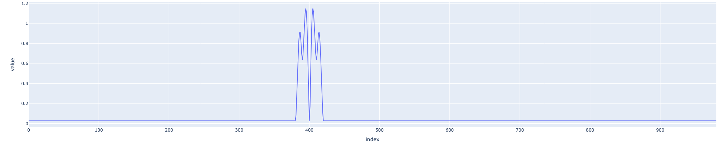
Distance Methods Example: MatrixProfile
…
Variations
Streaming: STAMPi, DAMP
Anytime: STAMP, STOMP
For reoccurring anomalies: left-STAMP
For multivariate time series: mSTAMP
closest neighbor
Chin-Chia Michael Yeh, Yan Zhu, Liudmila Ulanova, Nurjahan Begum, Yifei Ding, Hoang Anh Dau, Diego Furtado Silva, Abdullah Mueen, and Eamonn J. Keogh. 2016. Matrix Prole I: All Pairs Similarity Joins for Time Series. In ICDM.

Slide 22

Anomaly Detection Methods – by Family
Forecasting
Reconstruction
Encoding
Distance
Distribution
ARIMA, DeepAnT, DeepNAP, HealthESN, LSTM-AD, MedianMethod, MTAD-GAT, NumentaHTM, NoveltySVR, OceanWNN, RBForest, RForest, SARIMA, Telemanom, Torsk, Triple ES, XGBoosting
AE, Bagel, DAE, Donut, EncDec-AD, FFT, IE-CAE, LSTM-VAE, MSCRED, OmniAnomaly, PCI, PCC, RobustPCA, SR, SR-CNN, TAnoGan
Ensemble GI, GrammarViz, LaserDBN, MultiHMM, PST, Series2Graph, TARZAN, TSBitmap
CBLOF, COF, DBStream, HOT SAX, Hybrid KNN, k-Means, KNN, LOF, NormA-SJ, PS-SVM, SAND, SSA, STAMP, STOMP, Sub-LOF, VALMOD, Left STAMPi
COPOD, DWT-MLEAD, Fast-MCD, HBOS, NF, S-H-ESD, DSPOT, Sub-Fast-MCD

Slide 23
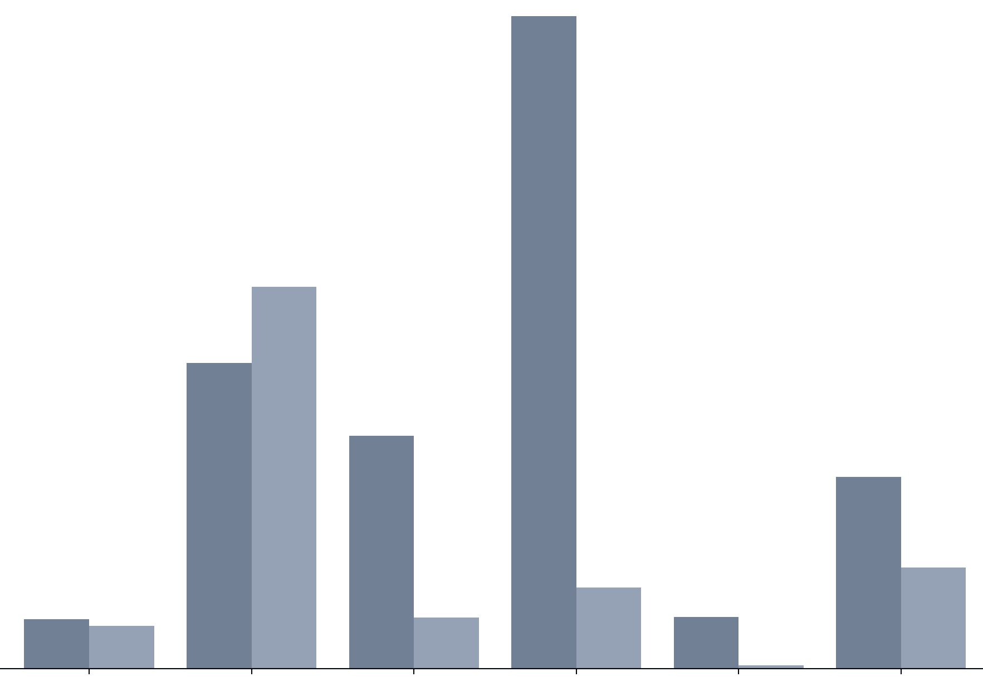
Distribution Methods
Methods estimate the distribution of the data or fit a distribution model to the data (frequency instead of distance)
Anomaly score = probabilities / likelihoods

Slide 24
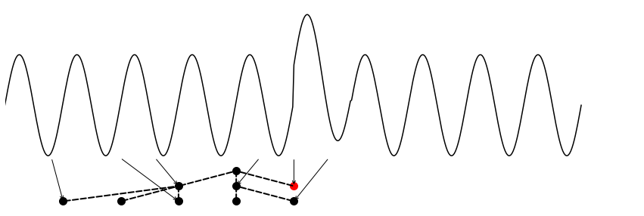
Anomaly Detection Methods – by Family
Forecasting
Reconstruction
Encoding
Distance
Distribution
Isolation Tree
ARIMA, DeepAnT, DeepNAP, HealthESN, LSTM-AD, MedianMethod, MTAD-GAT, NumentaHTM, NoveltySVR, OceanWNN, RBForest, RForest, SARIMA, Telemanom, Torsk, Triple ES, XGBoosting
AE, Bagel, DAE, Donut, EncDec-AD, FFT, IE-CAE, LSTM-VAE, MSCRED, OmniAnomaly, PCI, PCC, RobustPCA, SR, SR-CNN, TAnoGan
Ensemble GI, GrammarViz, LaserDBN, MultiHMM, PST, Series2Graph, TARZAN, TSBitmap
CBLOF, COF, DBStream, HOT SAX, Hybrid KNN, k-Means, KNN, LOF, NormA-SJ, PS-SVM, SAND, SSA, STAMP, STOMP, Sub-LOF, VALMOD, Left STAMPi
COPOD, DWT-MLEAD, Fast-MCD, HBOS, NF, S-H-ESD, DSPOT, Sub-Fast-MCD
EIF, HIF, IF-LOF, iForest, Sub-IF

Slide 25
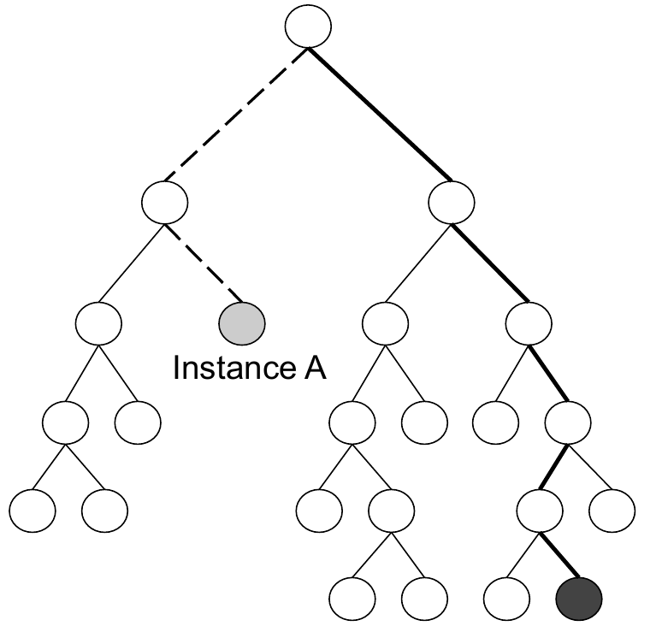
Isolation Tree Methods
Methods build an ensemble of random trees that partition the samples (points or subsequences)
Anomaly score = average reciprocal path length

Slide 26
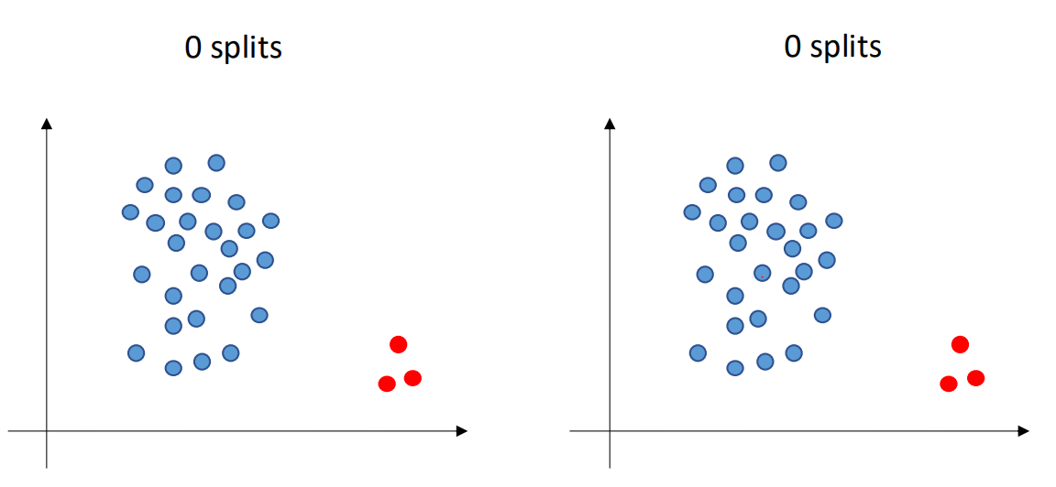
Isolation Tree Methods Example: Isolation Forest
…
Fei Tony Liu, Kai Ming Ting, and Zhi-Hua Zhou. 2008. Isolation Forest. In Proceedings of the International Conference on Data Mining (ICDM), 413–422. doi: 10.1109/ICDM.2008.17.

Slide 27
Isolation Tree Methods Example: Isolation Forest
Fei Tony Liu, Kai Ming Ting, and Zhi-Hua Zhou. 2008. Isolation Forest. In Proceedings of the International Conference on Data Mining (ICDM), 413–422. doi: 10.1109/ICDM.2008.17.
Screenshot from Boniol et al. Time-Series Anomaly Detection: Overview and New Trends. VLDB 2024

Slide 28
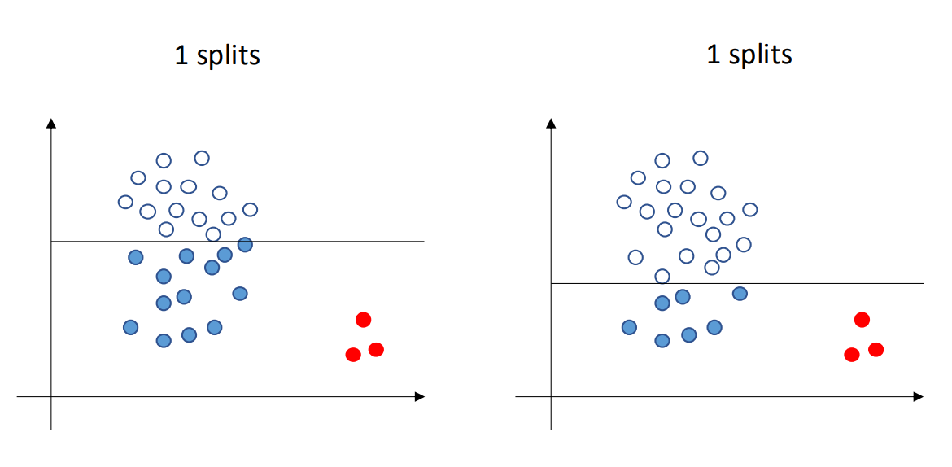
Isolation Tree Methods Example: Isolation Forest
Fei Tony Liu, Kai Ming Ting, and Zhi-Hua Zhou. 2008. Isolation Forest. In Proceedings of the International Conference on Data Mining (ICDM), 413–422. doi: 10.1109/ICDM.2008.17.
Screenshot from Boniol et al. Time-Series Anomaly Detection: Overview and New Trends. VLDB 2024

Slide 29
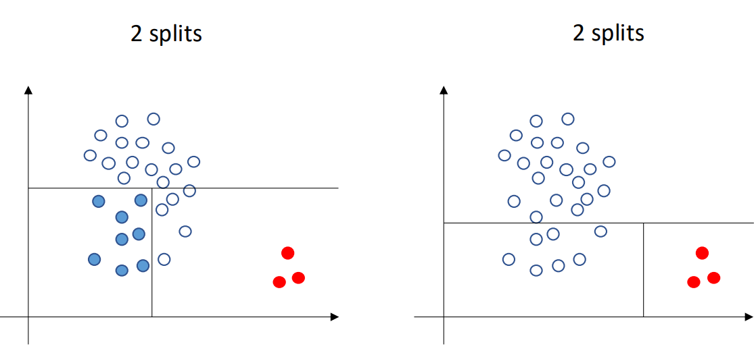
Isolation Tree Methods Example: Isolation Forest
Fei Tony Liu, Kai Ming Ting, and Zhi-Hua Zhou. 2008. Isolation Forest. In Proceedings of the International Conference on Data Mining (ICDM), 413–422. doi: 10.1109/ICDM.2008.17.
Screenshot from Boniol et al. Time-Series Anomaly Detection: Overview and New Trends. VLDB 2024

Slide 30
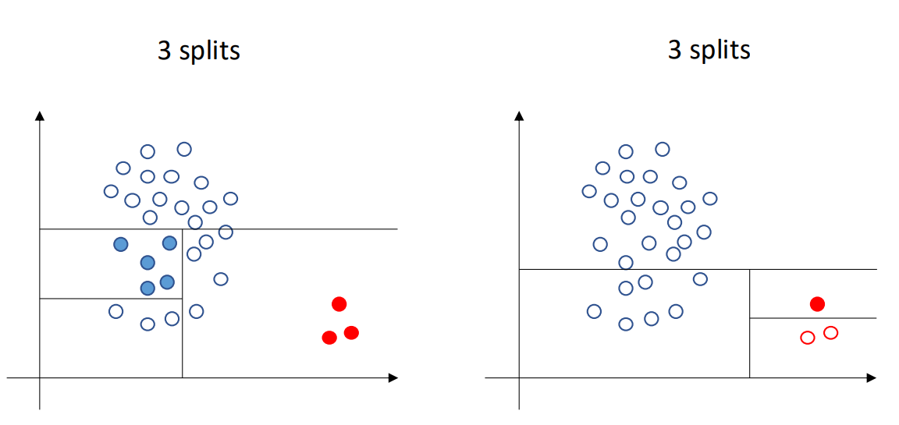
Isolation Tree Methods Example: Isolation Forest
Fei Tony Liu, Kai Ming Ting, and Zhi-Hua Zhou. 2008. Isolation Forest. In Proceedings of the International Conference on Data Mining (ICDM), 413–422. doi: 10.1109/ICDM.2008.17.
Screenshot from Boniol et al. Time-Series Anomaly Detection: Overview and New Trends. VLDB 2024

Slide 31
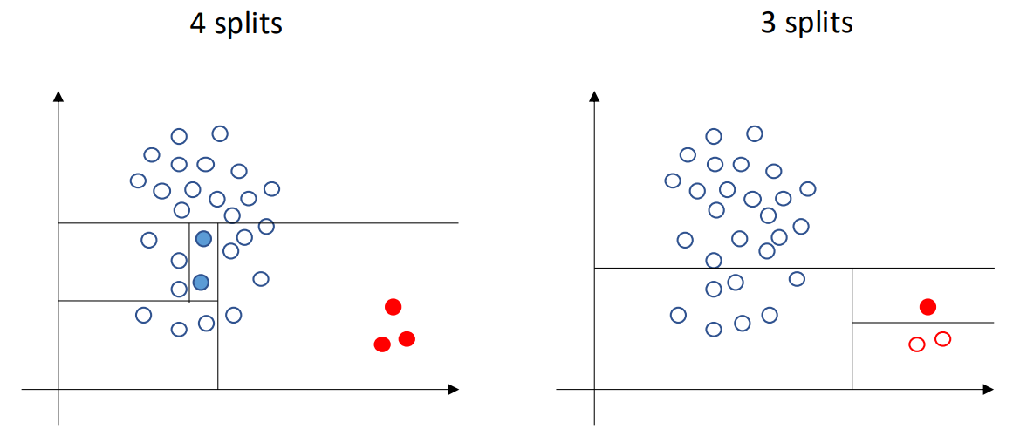
Isolation Tree Methods Example: Isolation Forest
Fei Tony Liu, Kai Ming Ting, and Zhi-Hua Zhou. 2008. Isolation Forest. In Proceedings of the International Conference on Data Mining (ICDM), 413–422. doi: 10.1109/ICDM.2008.17.
Screenshot from Boniol et al. Time-Series Anomaly Detection: Overview and New Trends. VLDB 2024

Slide 32
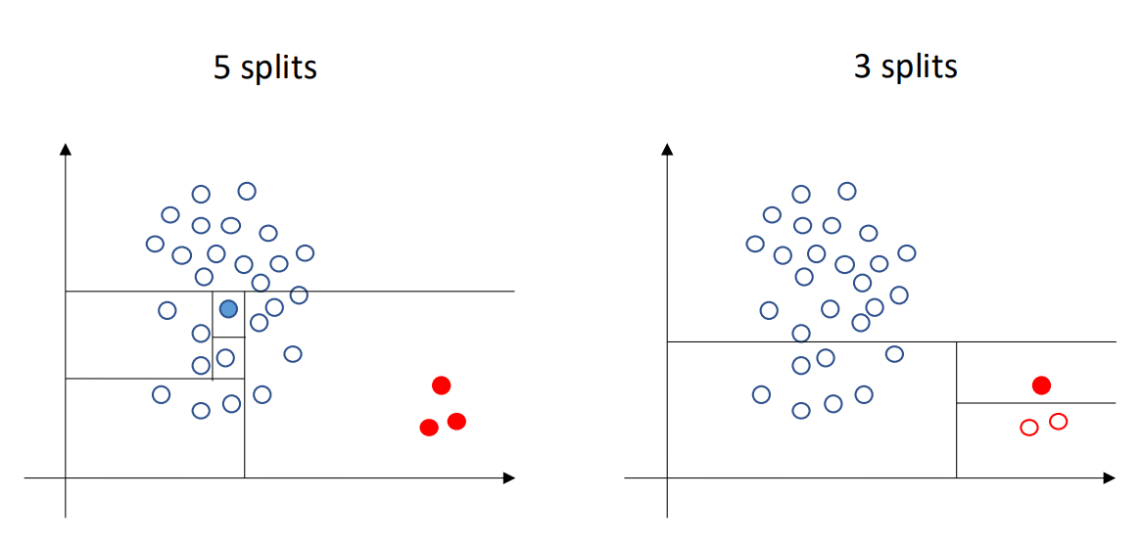
Isolation Tree Methods Example: Isolation Forest
Easier to isolate
Fei Tony Liu, Kai Ming Ting, and Zhi-Hua Zhou. 2008. Isolation Forest. In Proceedings of the International Conference on Data Mining (ICDM), 413–422. doi: 10.1109/ICDM.2008.17.
Screenshot from Boniol et al. Time-Series Anomaly Detection: Overview and New Trends. VLDB 2024

Slide 33
Isolation Tree Methods Example: Isolation Forest
…
Fei Tony Liu, Kai Ming Ting, and Zhi-Hua Zhou. 2008. Isolation Forest. In Proceedings of the International Conference on Data Mining (ICDM), 413–422. doi: 10.1109/ICDM.2008.17.

Slide 34
Anomaly Detection Methods in aeon
Forecasting
Reconstruction
Encoding
Distance
Distribution
Isolation Tree
ARIMA, DeepAnT, DeepNAP, HealthESN, LSTM-AD, MedianMethod, MTAD-GAT, NumentaHTM, NoveltySVR, OceanWNN, RBForest, RForest, SARIMA, Telemanom, Torsk, Triple ES, XGBoosting
AE, Bagel, DAE, Donut, EncDec-AD, FFT, IE-CAE, LSTM-VAE, MSCRED, OmniAnomaly, PCI, PCC, RobustPCA, SR, SR-CNN, TAnoGan
Ensemble GI, GrammarViz, LaserDBN, MultiHMM, PST, Series2Graph, TARZAN, TSBitmap
CBLOF, COF, DBStream, HOT SAX, Hybrid KNN, k-Means, KNN, LOF, NormA-SJ, PS-SVM, SAND, SSA, STAMP, STOMP, Sub-LOF, VALMOD, Left STAMPi
COPOD, DWT-MLEAD, Fast-MCD, HBOS, NF, S-H-ESD, DSPOT, Sub-Fast-MCD
EIF, HIF, IF-LOF, iForest, Sub-IF

Slide 35
TSAD Benchmark & Datasets
ECML/PKDD 2024 Tutorial
An Introduction to Machine Learning from Time Series

Slide 36
Benchmarks & Datasets
NAB
58 time series
Univariate
Real-world and synthetic
Streaming
Own scoring mechanism
Various domains
HEX/UCR
250 time series
Univariate
Manually checked labels
Only 1 annotated anomaly per time series
Various domains
TSB-UAD
2 000 time series
Univariate
No filtering
Proposes data transformations to introduce new anomalies in existing time series
Includes time series generated from classification datasets
976 time series
Uni- & multivariate
Only time series with contamination <0.1, at least one method above 0.8 ROC-AUC and at least one anomaly
Synthetic time series generator GutenTAG for parameter tuning
All datasets are available in aeon!

Slide 37
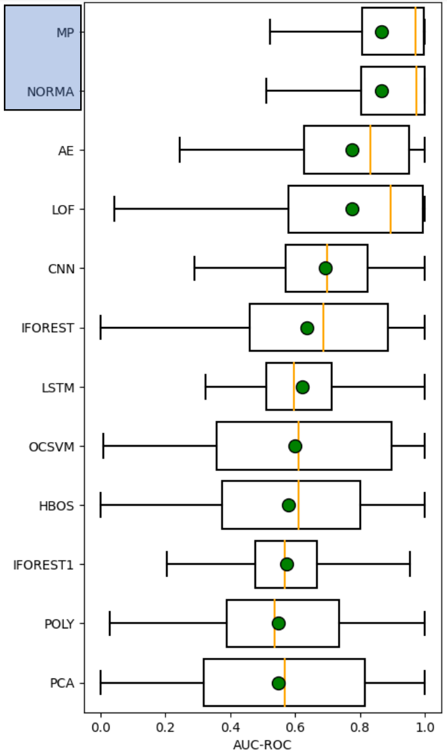
HEX/UCR Insights
Distance methods have better accuracy than forecasting or reconstruction methods
Renjie Wu and Eamonn J. Keogh. 2020. Current Time Series Anomaly Detection Benchmarks are Flawed and are Creating the Illusion of Progress. IEEE Transactions on Knwoledge & Data Engineering, vol. 35, no. 04, 2023.
Image from Boniol et al. Time-Series Anomaly Detection: Overview and New Trends. VLDB 2024

Slide 38
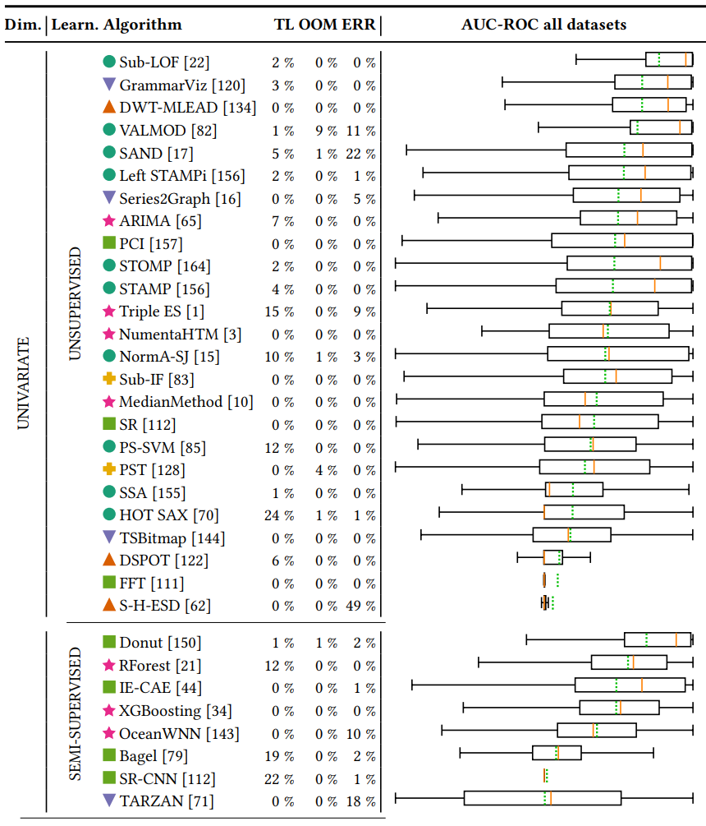
TimeEval Insights
Distance methods have better accuracy than forecasting or reconstruction methods
Semi-supervised are NOT outperforming unsupervised
There is no overall winner!
Sebastian Schmidl, Phillip Wenig, Thorsten Papenbrock: Anomaly Detection in Time Series: A Comprehensive Evaluation. PVLDB 9:(15), 2022. DOI:10.14778/3538598.3538602

Slide 39
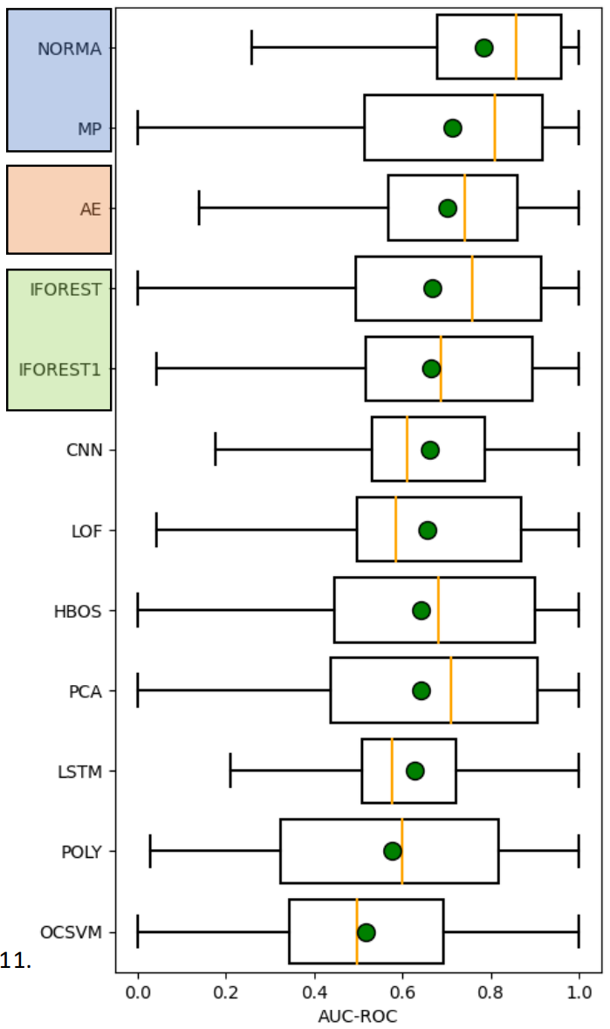
TSB-UAD Insights
Distance methods have better accuracy than forecasting methods
Isolation Forest is very competitive
John Paparrizos, Yuhao Kang, Paul Boniol, Ruey S. Tsay, Themis Palpanas, and Michael J. Franklin. 2022. TSB-UAD: an end-to-end benchmark suite for univariate time-series anomaly detection. Proc. VLDB Endow. 15, 8 (2022).
Image from Boniol et al. Time-Series Anomaly Detection: Overview and New Trends. VLDB 2024

Slide 40
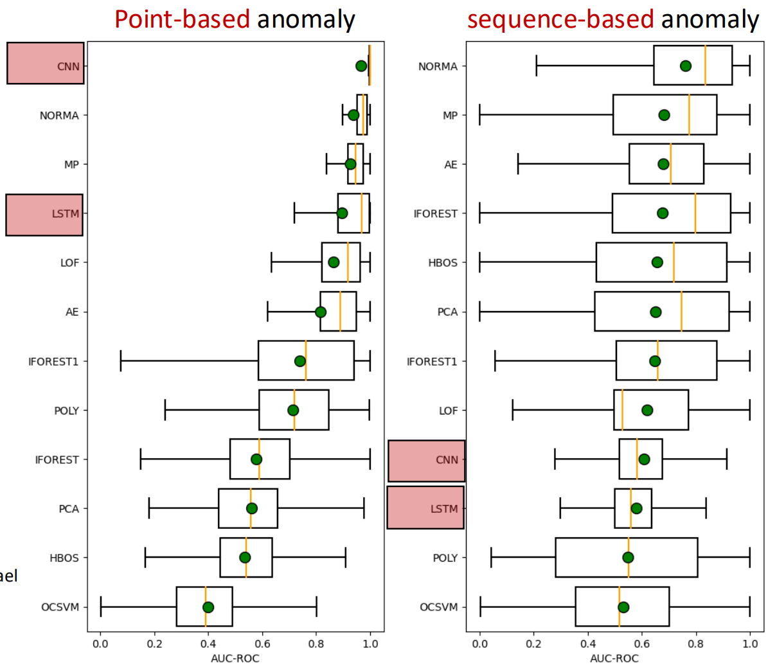
TSB-UAD Insights
Distance methods have better accuracy than forecasting methods
Isolation Forest is very competitive
Forecasting methods are good at detecting point anomalies, but bad at detecting subsequence anomalies
There is no overall winner!
John Paparrizos, Yuhao Kang, Paul Boniol, Ruey S. Tsay, Themis Palpanas, and Michael J. Franklin. 2022. TSB-UAD: an end-to-end benchmark suite for univariate time-series anomaly detection. Proc. VLDB Endow. 15, 8 (2022).
Image from Boniol et al. Time-Series Anomaly Detection: Overview and New Trends. VLDB 2024

Slide 41
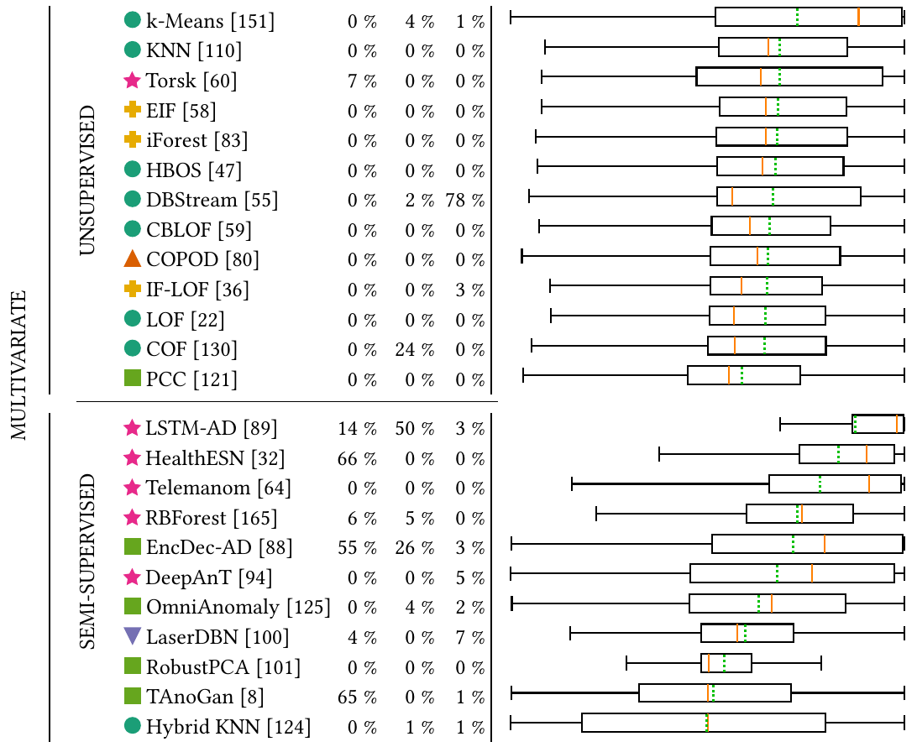
Multivariate: TimeEval Insights
k-Means and Telemanom stand out
Overall bad accuracy
Semi-supervised often exceed resource limits, but are outperforming unsupervised slightly
There is no overall winner!

Slide 42
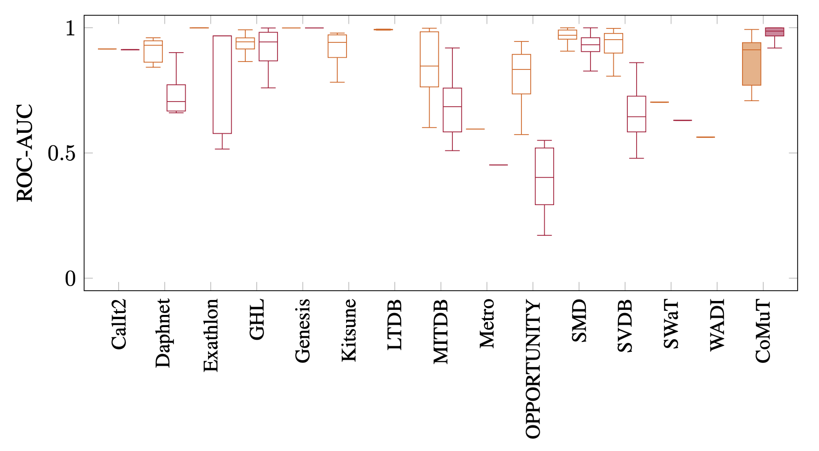
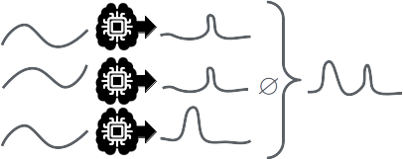
Multivariate: Datasets are too easy
Max ROC-AUC per time series over all algorithms
Univariate
Multivariate
Univariate algorithm on multivariate time series:
Phillip Wenig, Sebastian Schmidl, Thorsten Papenbrock: Anomaly Detectors for Multivariate Time Series: The Proof of the Pudding is in the Eating. Proceedings of the International Conference on Data Engineering Workshops (ICDEW), 2024. DOI:10.1109/ICDEW61823.2024.00018

Slide 43
Multivariate: Datasets are too easy
Max ROC-AUC per time series over all algorithms
Univariate
Multivariate
Univariate algorithm on multivariate time series:
Phillip Wenig, Sebastian Schmidl, Thorsten Papenbrock: Anomaly Detectors for Multivariate Time Series: The Proof of the Pudding is in the Eating. Proceedings of the International Conference on Data Engineering Workshops (ICDEW), 2024. DOI:10.1109/ICDEW61823.2024.00018

Slide 44
Outlook
ECML/PKDD 2024 Tutorial
An Introduction to Machine Learning from Time Series

Slide 45
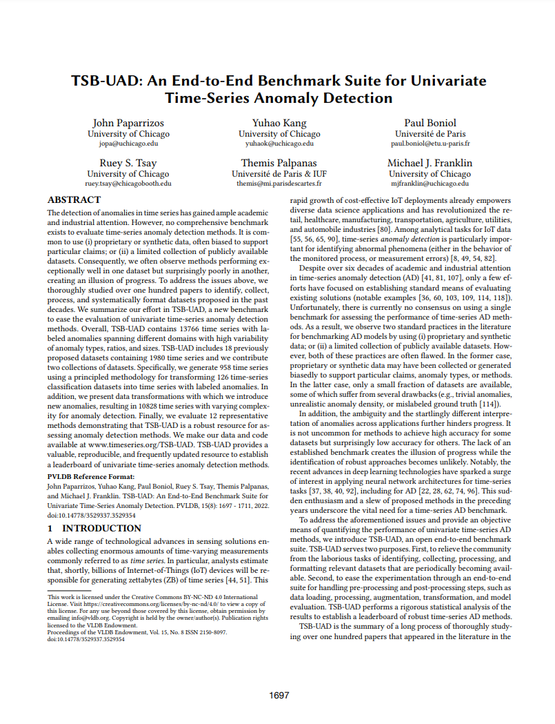
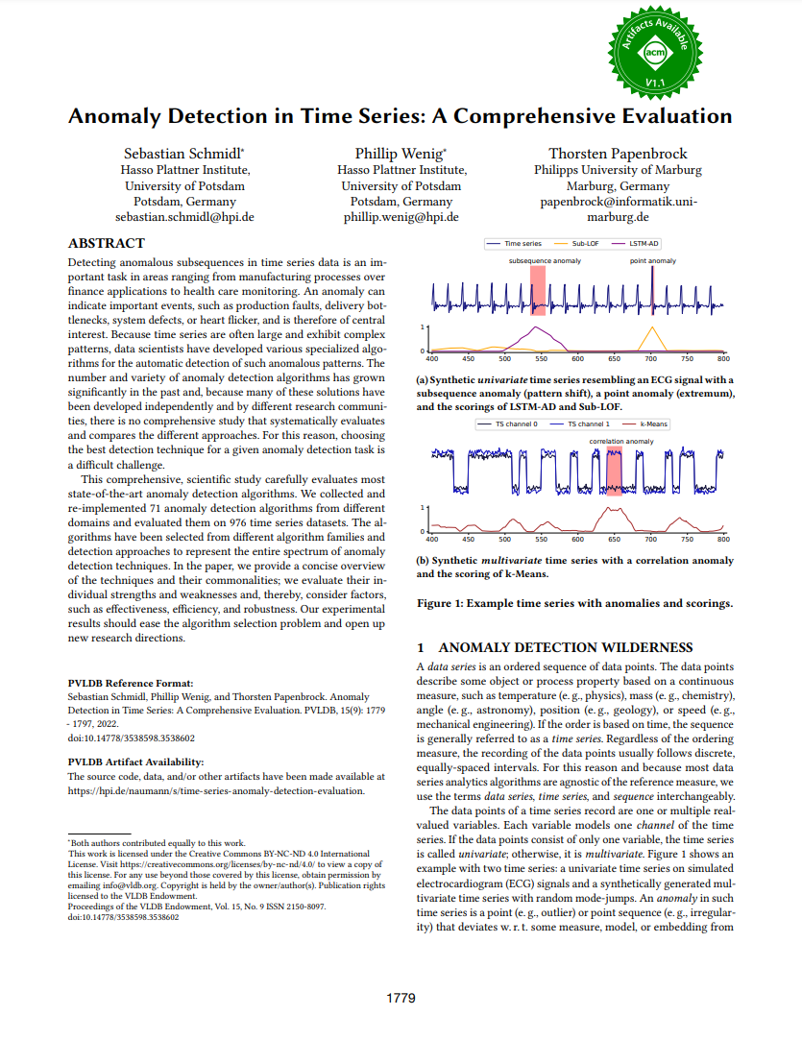
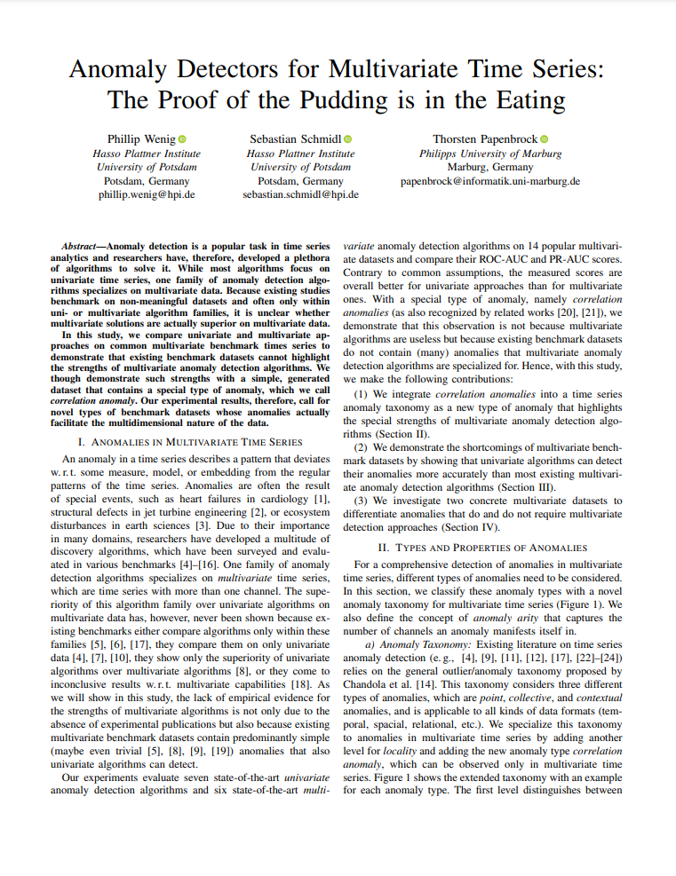
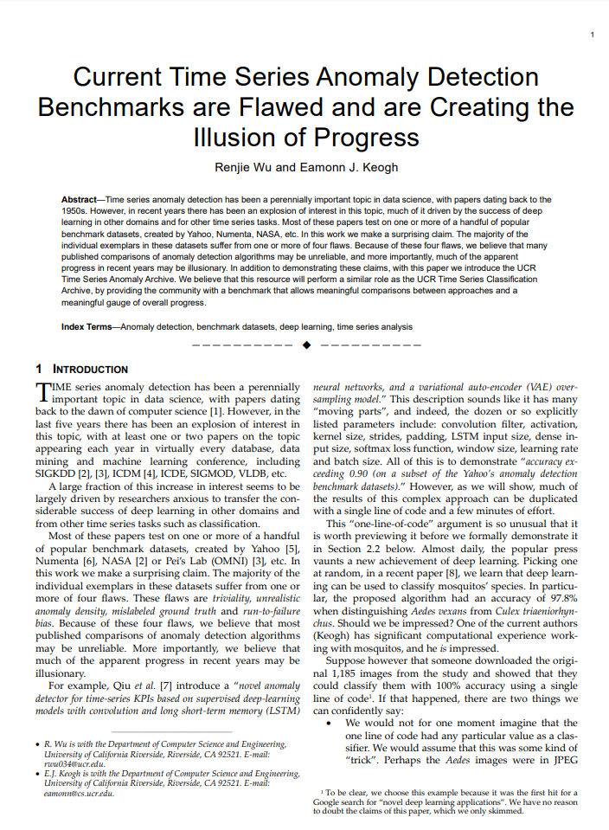
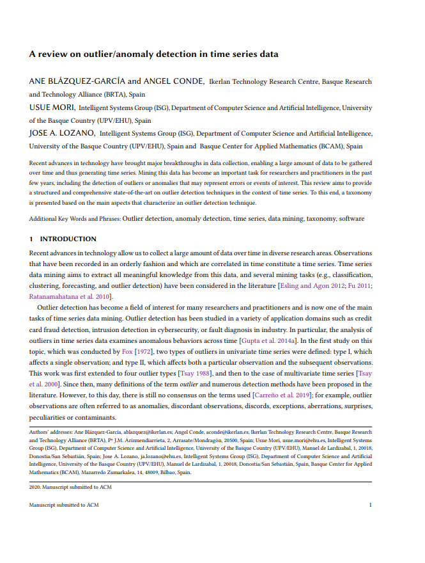
Recommended Reads
Evaluation and Survey Papers
Paparrizos et al. PVLDB (2022) https://doi.org/10.1109/ICDEW61823.2024.00018
Schmidl et al. PVLDB (2022)
https://doi.org/10.14778/3538598.3538602
Wenig et al. ICDEW (2024) https://doi.org/10.1109/ICDEW61823.2024.00018
Wu et al. TKDE (2023) https://doi.org/10.1109/TKDE.2021.3112126
Blázquez-García et al. ACM Comput Surv (2021) https://doi.org/10.1145/3444690

Slide 46
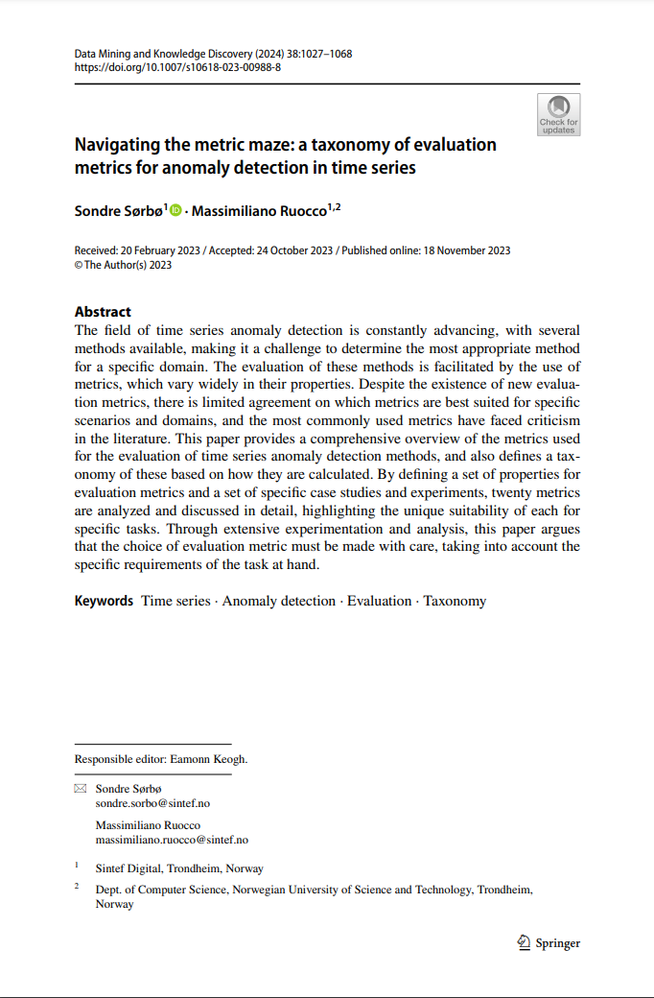
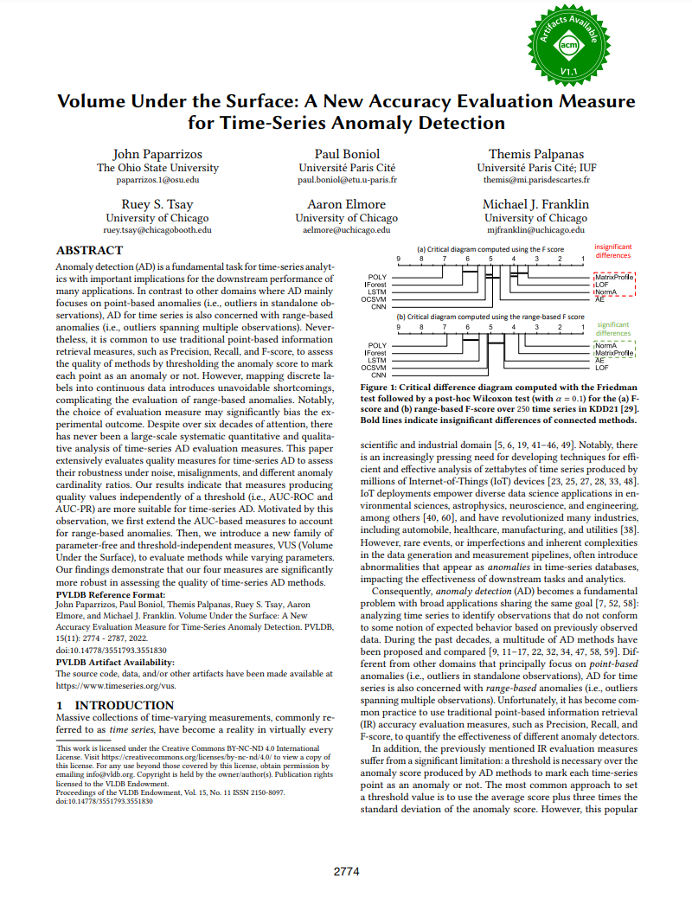
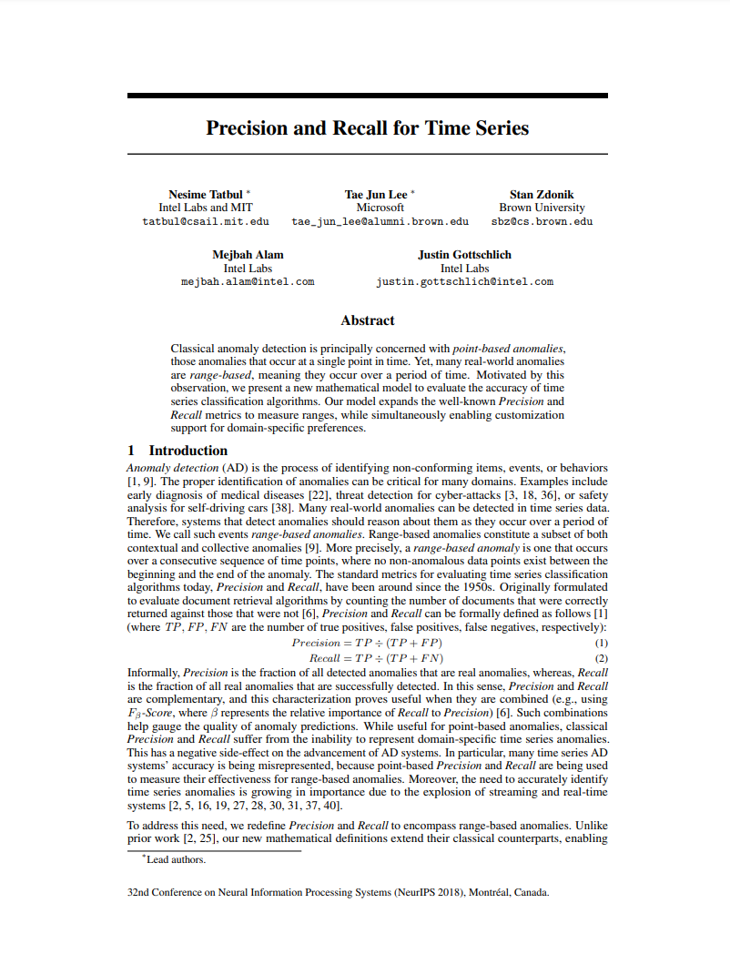
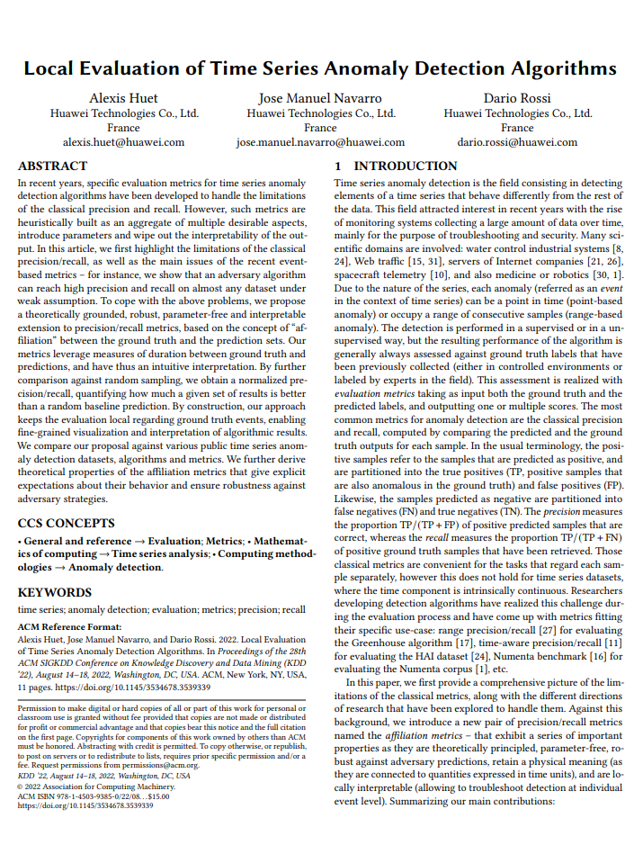
Recommended Reads
Metric Papers
Sørbø et al. Data Min Knowl Disc (2024)
https://doi.org/10.1007/s10618-023-00988-8
Paparrizos et al. PVLDB (2022) https://doi.org/10.14778/3551793.3551830
Tatbul et al. NeurIPS (2018) https://doi.org/10.1145/3444690
Huet et al. KDD (2022) https://doi.org/10.1145/3534678.3539339

Slide 47
Future Work
For Research
Automatic method selection and ensembling methods
No one-size-fits-all solution, but already 100s of methods
More and better benchmarks
Existing benchmark datasets have flaws
Existing evaluations are biased
TS Foundation Models
Explainability / Precursor Detection / Anomaly Classification
In aeon
Add more detectors (especially deep learning)
Add missing metrics

Slide 48
Example code
M.Middlehurst@uea.ac.uk
See part6_anomaly_detection.ipynb

Slide 49
Thank you!
ECML/PKDD 2024 Tutorial
An Introduction to Machine Learning from Time Series
NEXT: Deep Learning by Ali Ismail-Fawaz

Slide 50
Datasets repositories
HEX/UCR
NASA
TSB-UAD
…

